Slide 1
Code and Load
Presented by Cosairus Software Engineering, LLC
November 27th, 2018 @ UWG

Slide 2
Overview
Introductions
Download the Project, Setup the Database
Add some features, fix some bugs
Discuss the technologies, tools
Win Fabulous Prizes!

Slide 3
Introductions
Cosairus Software Engineering, LLC in Atlanta, GA
Founded 1996
26 Employees
Microsoft Technology Stack
Clients in Medical, Staffing, Payroll, Finance, and Government

Slide 4
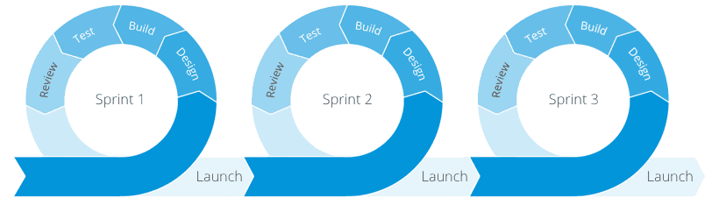
Agile Development Process
Individuals and interactions over processes and tools
Working software over comprehensive documentation
Customer collaboration over contract negotiation
Responding to change over following a plan

Slide 5
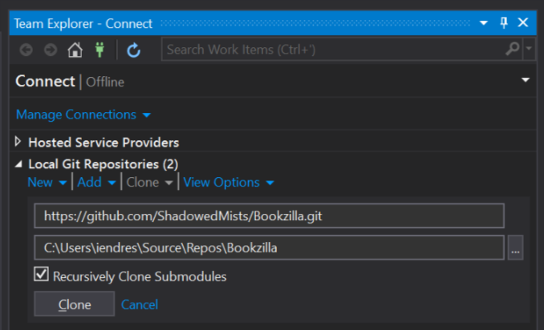
Download the Project
https://bit.ly/2PNzc8Y
Open Visual Studio
Open Team Explorer
Clone
Open and Build Solution

Slide 6
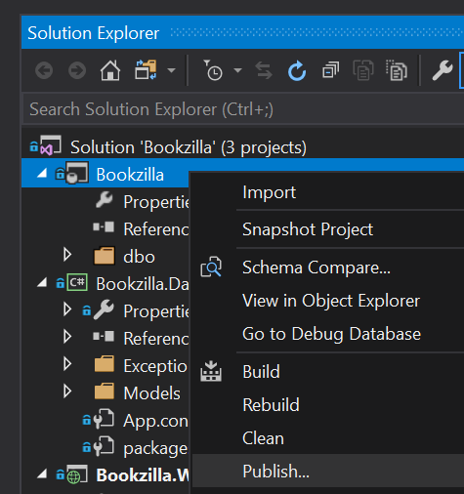
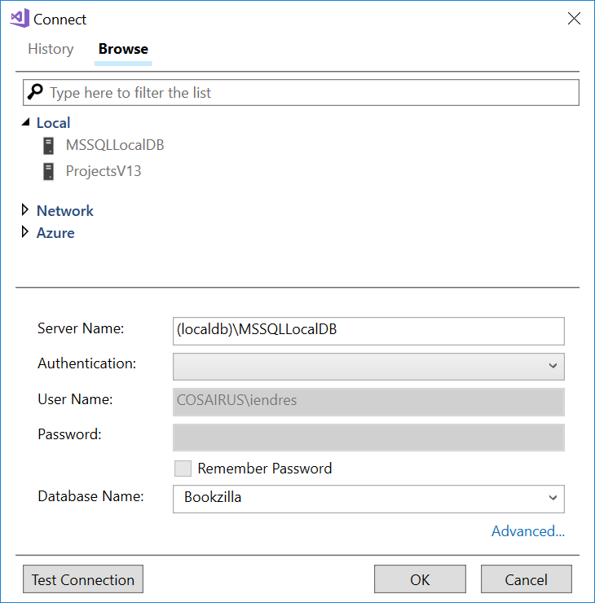
Setup the Database
Solution Explorer > Bookzilla, Right-click > Publish
Edit > Target Database Connection > Publish
Server Name = (localdb)\MSSQLLocalDB, Database Name = Bookzilla

Slide 7
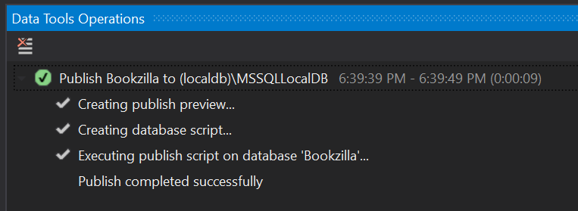
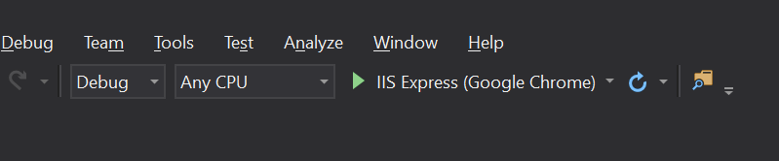
Setup the Database
Once completed, Execute IIS Express to run the Web Project

Slide 8
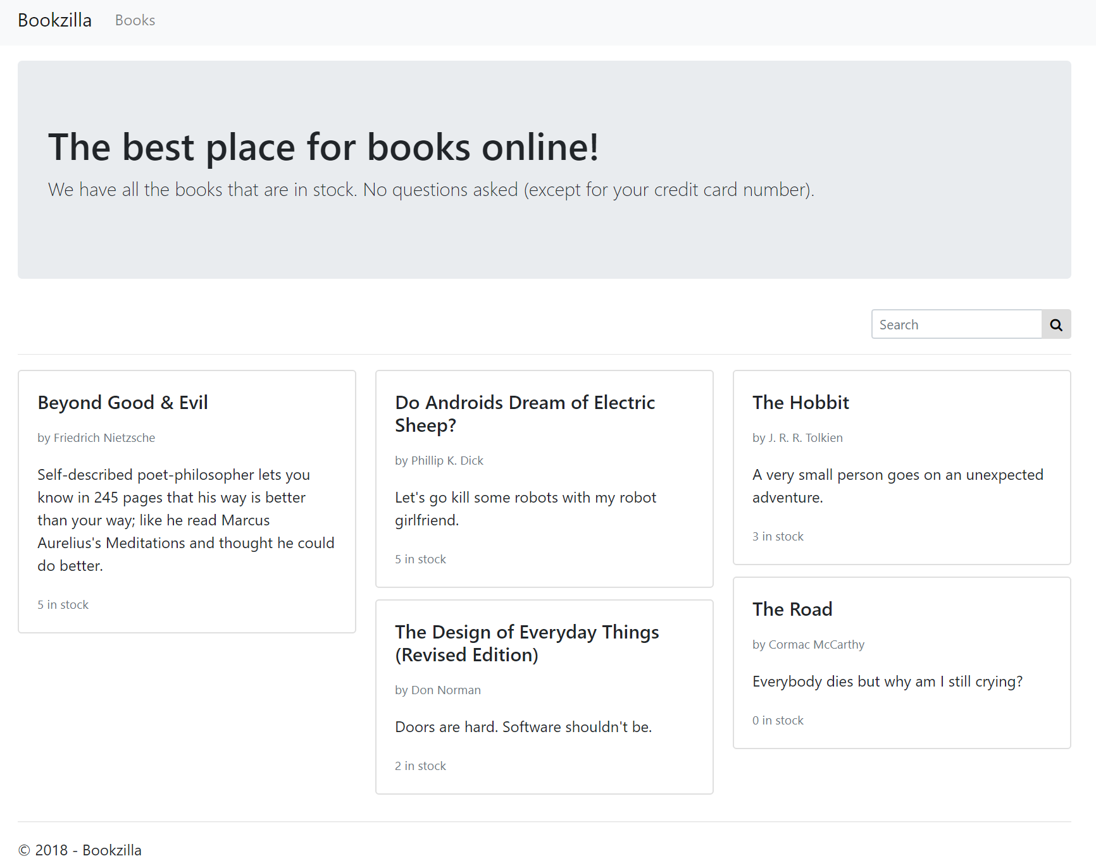
Should Look Like This

Slide 9
Client Email Alert!
From: Tom
Subject: Book Search
Every time I try to search by ISBN nothing shows up. I put in all the ISBN numbers for every book but this never seems to work! I just put in Electric Sheep (978-0-345-40447-3) and I can only find that copy by title or author and scrolling through the versions. This needs to get fixed ASAP!

Slide 10
Book Search Needs to Search by ISBN
Edit the Bookzilla\dbo\Stored Procedures\p_BookSearch.sql file to search on ISBN
Schema Compare the change to the database
Bookzilla > Right-click > Schema Compare
Source: Bookzilla Project
Target: Bookzilla Database
Test

Slide 11
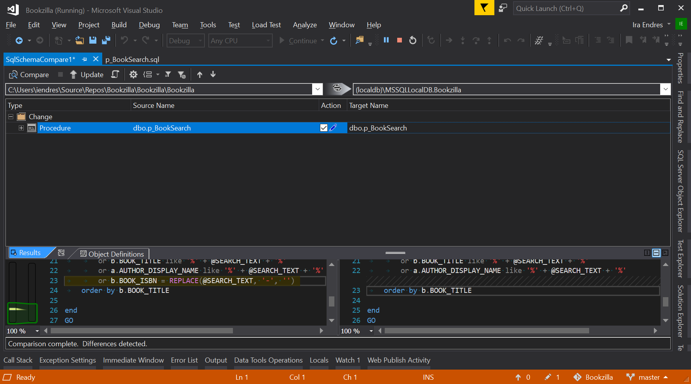
SSDT Schema Comparison

Slide 12
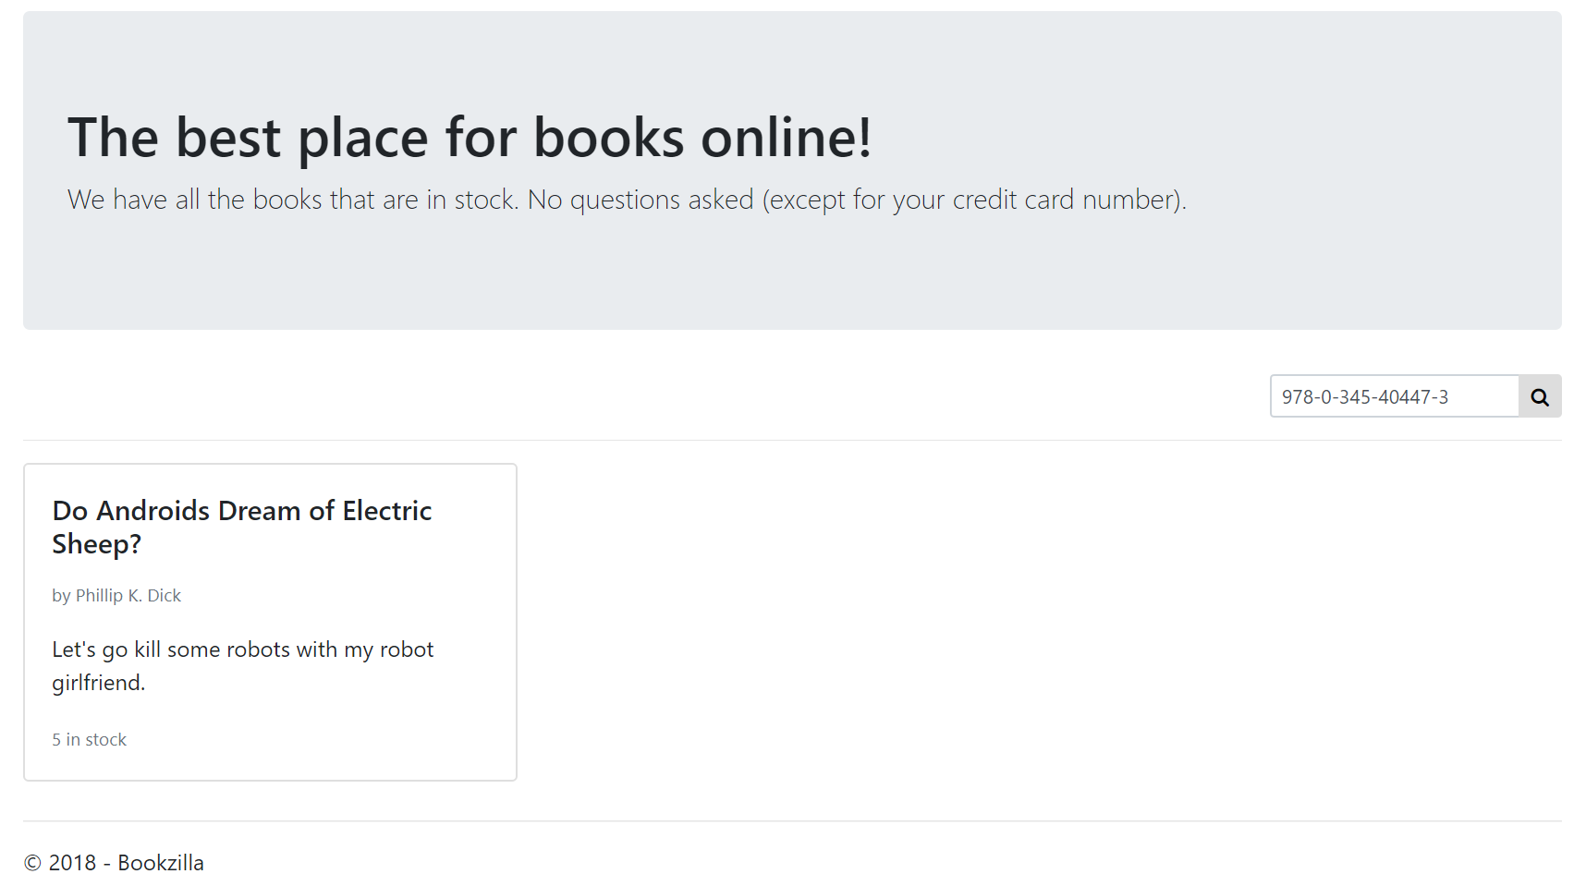
Book Search Needs to Search by ISBN

Slide 13
Client Email Alert!
From: Tom
Subject: RE: Book Search
While you are editing the book search, it really needs to show just in stock items. We still need to be able to see out-of-stock items too. Our customers are trying to buy things they see on the site but we don’t have in stock.
------------------------------------------------------
Every time I try to search by ISBN nothing shows up. I put in all the ISBN numbers for every book but this never seems to work! I just put in Electric Sheep (978-0-345-40447-3) and I can only find that copy by title or author and scrolling through the versions. This needs to get fixed ASAP!

Slide 14
Book Search Should Only Show In-Stock Items
Edit the p_BookSearch.sql file with a new parameter to show in stock items if true
Schema Compare the change to the database
Update the Entity Framework Function Import for p_BookSearch
Update Bookzilla.Web\Models\BookSearchModel.cs to include the new flag
Add a checkbox on Views\Home\Index.cshtml to set the flag
Default to checked
Test

Slide 15
Update the p_BookSearch
Add parameter
@SHOW_IN_STOCK_ONLY bit = 1
Add to where clause
(i.QUANTITY_IN_STOCK > 0 or @SHOW_IN_STOCK_ONLY = 0)
Think about the order of operations in the where clause
Schema Compare to the database

Slide 16
Update the Entity Framework Model
Open the ADO.NET Entity Framework Model
Bookzilla.Database\Models\BookzillaModel.edmx
Right-click in the designer and select Update Model from Database
Click Finish
Save and Build

Slide 17
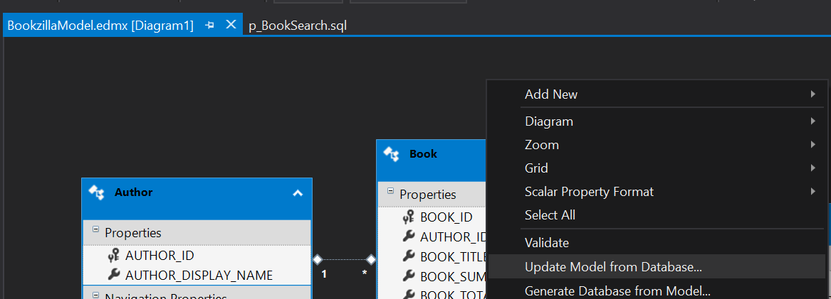
Update the Entity Framework Model

Slide 18
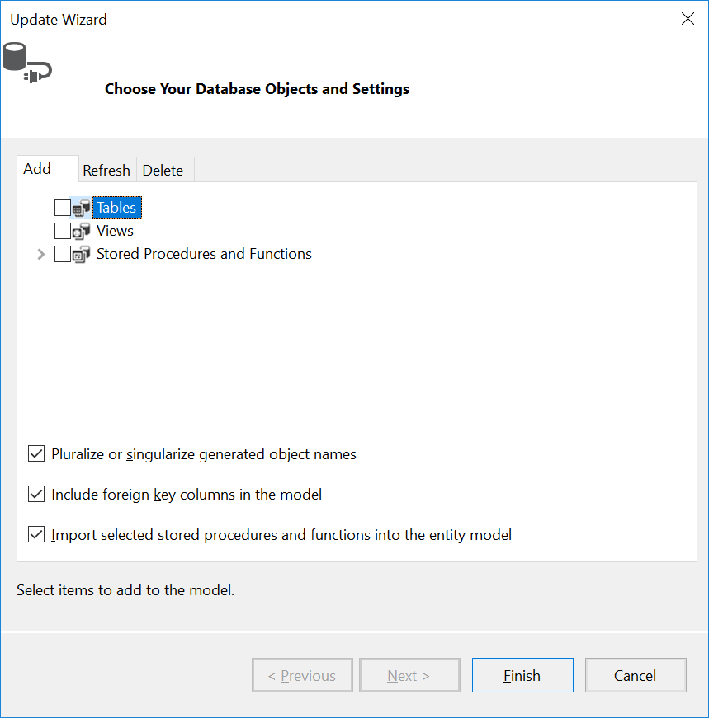
Update the Entity Framework Model

Slide 19
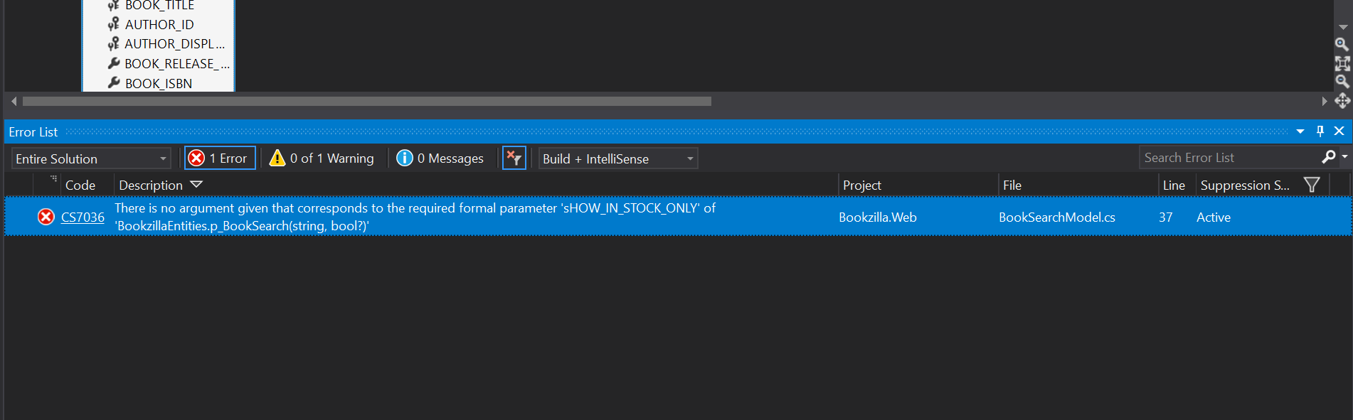
Uh-oh
Double click the error to jump to the line of code

Slide 20
Update BookSearchModel
Add a new property to Bookzilla.Web\Models\BookSearchModel.cs
public bool InStockOnly { get; set; } = true;
Pass the new property as the second parameter to the p_BookSearch

Slide 21
Update the Homepage Razor File
Edit Bookzilla.Web\Views\Home\Index.cshtml
Remove the @* and *@ to enable the checkbox

Slide 22
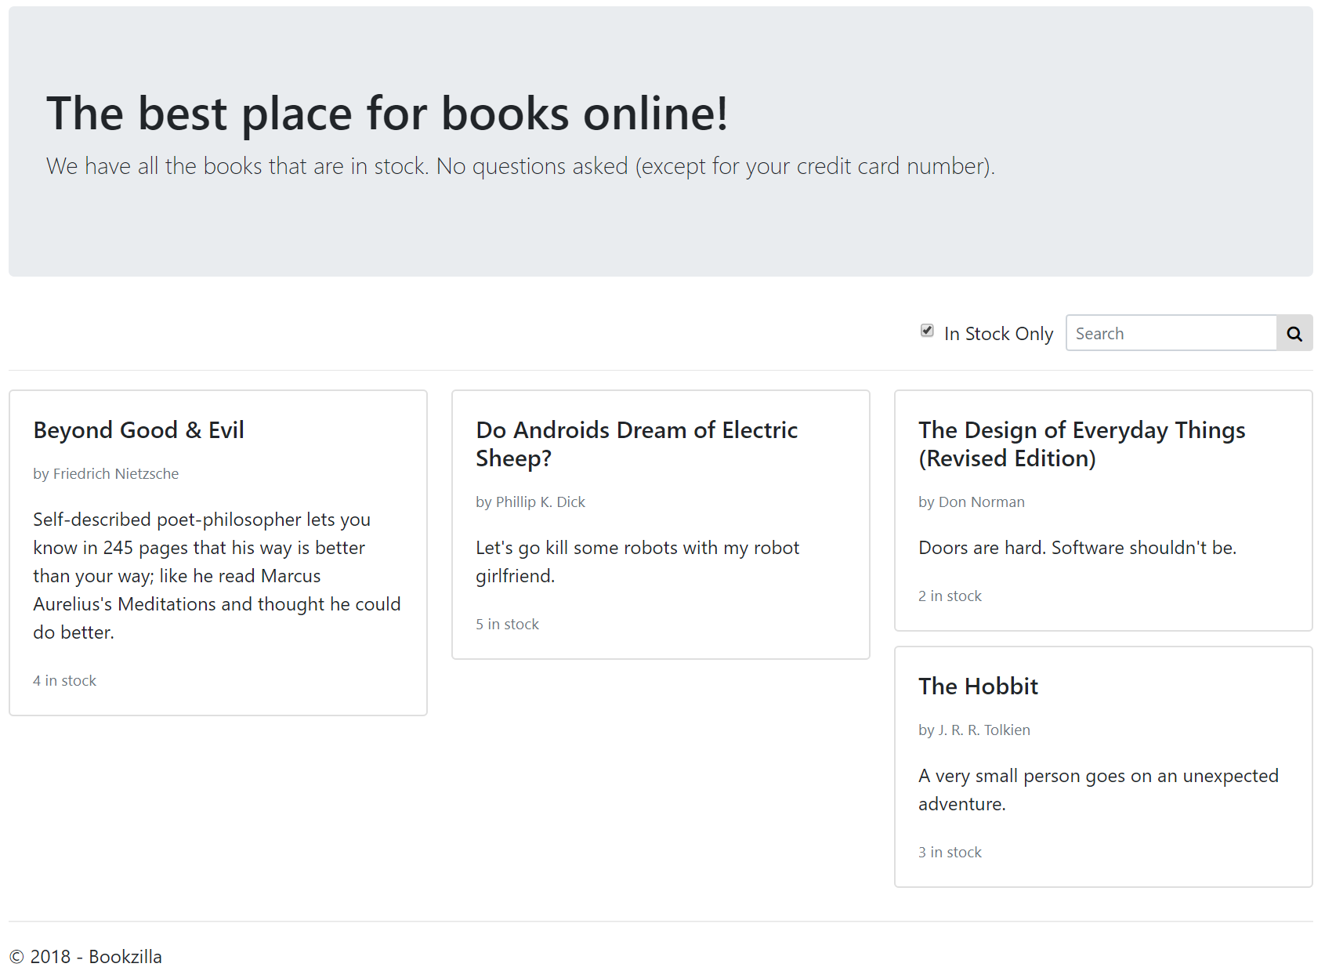
Book Search Should Only Show In-Stock Items

Slide 23
Client Email Alert!
From: Tom
Subject: Can’t Delete Books EOM

Slide 24
Resolve the Delete Book Foreign Key Error
Two Approaches:
Use the Entity Framework
Use a Stored Procedure
For Stored Procedure approach:
Fill out p_BookDelete
Schema Compare
Update EDMX

Slide 25
Technology and Tools
Microsoft Visual Studio 2017
Microsoft ASP.NET MVC 5
Microsoft SQL Server Data Tools 2017
Microsoft SQL Server Express LocalDB
Microsoft Entity Framework 6

Slide 26
Design Patterns Used
Model View Controller (MVC)
Model View View-Model (MVVM)
Data Context Interaction (DCI) – Entity Framework
Data Transfer Objects (DTO)

Slide 27
The End
Thanks for your participation!

